Slide 1


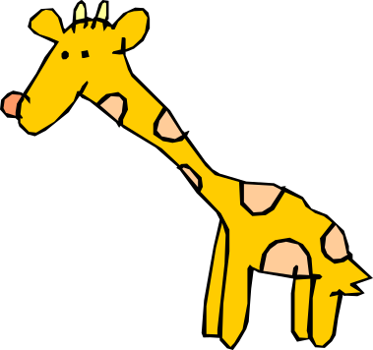

Discrete Maths
Chapter 3: Minimum Connector Problems
Lesson 1: Prim’s and Kruskal

Slide 2
Can we remember those trees…

Slide 3
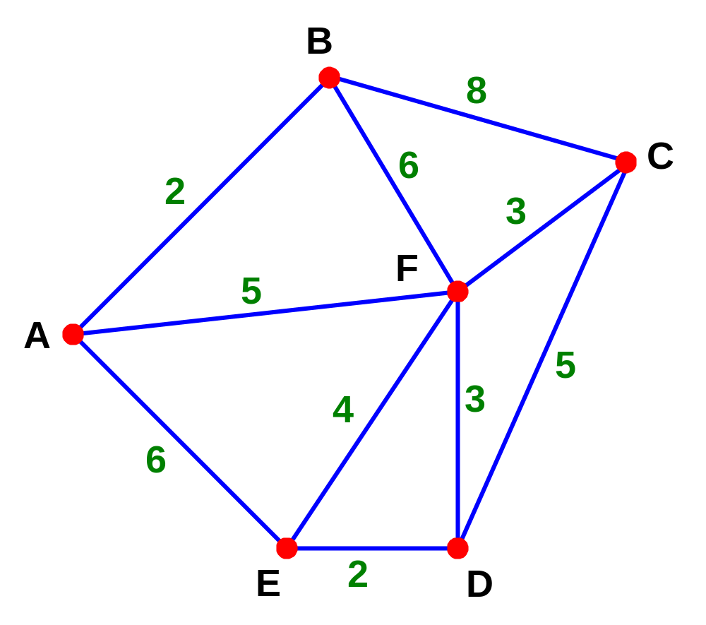
A tree is a connected graph of some vertices which contains no cycles

Slide 4
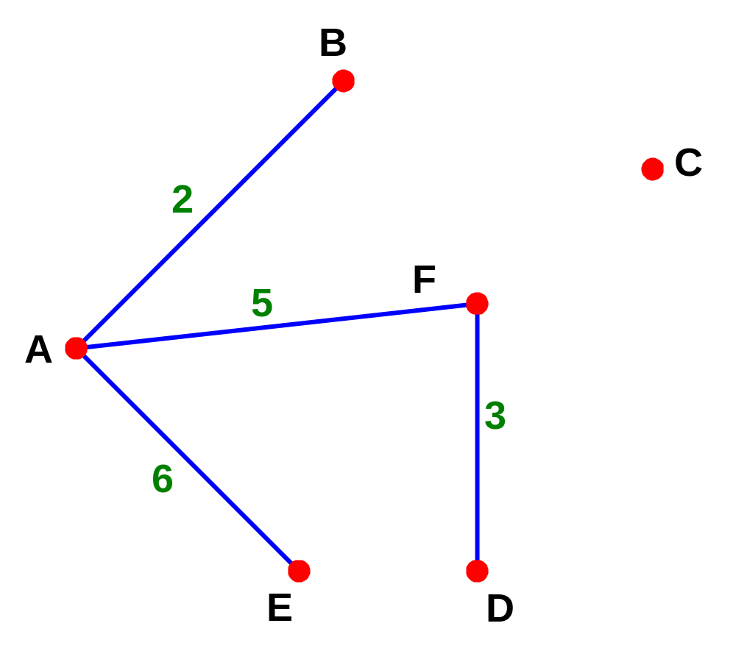
A tree is a connected graph of some vertices which contains no cycles

Slide 5
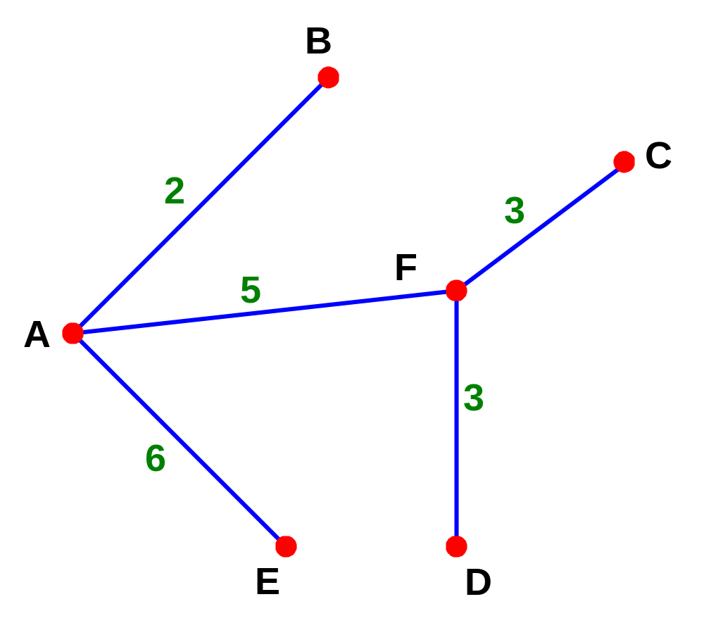
A spanning tree is a connected graph of all vertices which contains no cycles

Slide 6
The minimum spanning tree is the spanning tree with the least weight
Length of this tree is 19

Slide 7
The minimum spanning tree is the spanning tree with the least weight
Can you find the least weight?

Slide 8
The minimum spanning tree is the spanning tree with the least weight
The least weight is 15

Slide 9
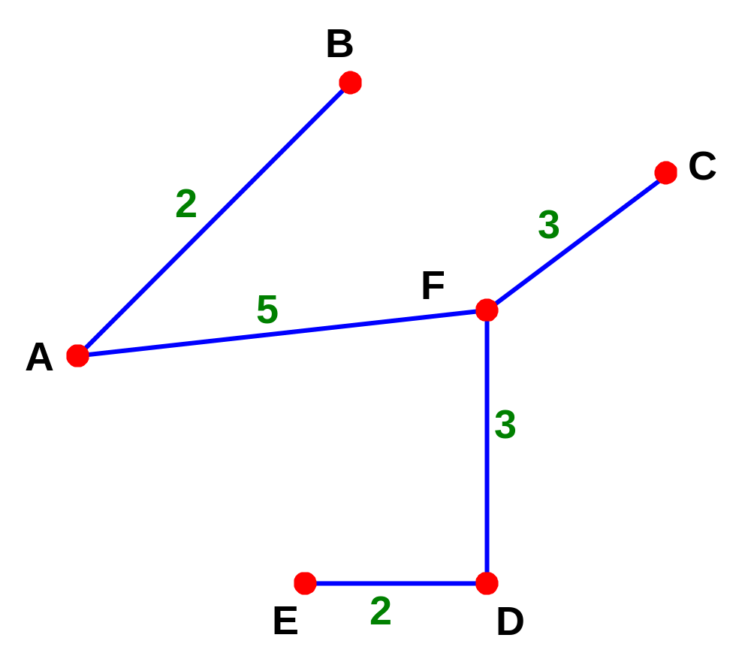
The minimum spanning tree is the spanning tree with the least weight
The least weight is 15

Slide 10
Notes
A tree (a connected graph with no cycles) which connects all the nodes together is called a Spanning Tree
For any connected graph with n nodes, each spanning tree will have n - 1 arcs
The Minimum Spanning Tree is the one with the Minimum weight

Slide 11
More Notes
Prim’s Algorithm is a quick way of finding the Minimum Spanning Tree (or minimum connector)
This algorithm is said to be “greedy” since it picks the immediate best option available without taking into account the long-term consequences of the choices made.
Kruskal’s Algorithm may also be used to find a minimum spanning tree, but this considers the weights themselves rather than the connecting points

Slide 12
Prim’s Algorithm
Aim: To find a minimum spanning tree T
Step 1: Select any node to be the first node of T.
Step 2: Consider the arcs which connect nodes in T to nodes outside T. Pick the one with minimum weight. Add this arc and the extra node to T. (If there are two or more arcs of minimum weight, choose any one of them.)
Step 3: Repeat Step 2 until T contains every node of the graph.

Slide 13
Kruskal’s Algorithm
Aim: To find a minimum spanning tree for a connected graph with n nodes:
Step 1: Choose the arc of least weight.
Step 2: Choose from those arcs remaining the arc of least weight which does not form a cycle with already chosen arcs. (If there are several such arcs, choose one arbitrarily.)
Step 3: Repeat Step 2 until n – 1 arcs have been chosen.

Slide 14
Manchester
40
30
Liverpool
Sheffield
110
70
40
Shrewsbury
50
80
50
Nottingham
B/ham
Aberystwyth
110
70
100
120
90
50
Oxford
Bristol
Cardiff
80
70
Southampton

Slide 15
Manchester
40
30
Liverpool
Sheffield
110
70
40
Shrewsbury
50
80
50
Nottingham
B/ham
Aberystwyth
110
70
100
120
90
50
Oxford
Bristol
Cardiff
80
70
Southampton

Slide 16
Manchester
40
30
Liverpool
Sheffield
110
70
40
Shrewsbury
50
80
50
Nottingham
B/ham
Aberystwyth
110
70
100
120
90
50
Oxford
Bristol
Cardiff
80
70
Southampton

Slide 17
Manchester
40
30
Liverpool
Sheffield
110
70
40
Shrewsbury
50
80
50
Nottingham
B/ham
Aberystwyth
110
70
100
120
90
50
Oxford
Bristol
Cardiff
80
70
Southampton

Slide 18
Manchester
40
30
Liverpool
Sheffield
110
70
40
Shrewsbury
50
80
50
Nottingham
B/ham
Aberystwyth
110
70
100
120
90
50
Oxford
Bristol
Cardiff
80
70
Southampton

Slide 19
Manchester
40
30
Liverpool
Sheffield
110
70
40
Shrewsbury
50
80
50
Nottingham
B/ham
Aberystwyth
110
70
100
120
90
50
Oxford
Bristol
Cardiff
80
70
Southampton

Slide 20
Manchester
40
30
Liverpool
Sheffield
110
70
40
Shrewsbury
50
80
50
Nottingham
B/ham
Aberystwyth
110
70
100
120
90
50
Oxford
Bristol
Cardiff
80
70
Southampton

Slide 21
Manchester
40
30
Liverpool
Sheffield
110
70
40
Shrewsbury
50
80
50
Nottingham
B/ham
Aberystwyth
110
70
100
120
90
50
Oxford
Bristol
Cardiff
80
70
Southampton

Slide 22
Manchester
40
30
Liverpool
Sheffield
110
70
40
Shrewsbury
50
80
50
Nottingham
B/ham
Aberystwyth
110
70
100
120
90
50
Oxford
Bristol
Cardiff
80
70
Southampton

Slide 23
Manchester
40
30
Liverpool
Sheffield
110
70
40
Shrewsbury
50
80
50
Nottingham
B/ham
Aberystwyth
110
70
100
120
90
50
Oxford
Bristol
Cardiff
80
70
Southampton

Slide 24
Manchester
40
30
Liverpool
Sheffield
110
70
40
Shrewsbury
50
80
50
Nottingham
B/ham
Aberystwyth
110
70
100
120
90
50
Oxford
Bristol
Cardiff
80
70
Southampton

Slide 25
Manchester
40
30
Liverpool
Sheffield
110
70
40
Shrewsbury
50
80
50
Nottingham
B/ham
Aberystwyth
110
70
100
120
90
50
Oxford
Bristol
Cardiff
80
70
Southampton

